Slide 1


Slide 2


AIMS OF THIS
SESSION
Provide an overview of the test
Discuss test details
Give examples of test items
Discuss effective test taking strategies / tips

Slide 3
READING
CRITERIA
C | Can understand and interpret critically virtually all forms of the written language.
B2 | Can read with a large degree of independence, adapting style and speed of reading to different texts and purposes, and using appropriate reference sources selectively.
B1 | Can read straightforward factual texts on subjects related to his/her field and interest with a satisfactory level of comprehension.
A2 | Can understand short, simple texts on familiar matters of a concrete type which consist of high frequency everyday or job-related language.
A1 | Can understand very short, simple texts a single phrase at a time, picking up familiar names, words and basic phrases and rereading as required.
A0 | Not enough language knowledge demonstrated to allow for any meaningful inferences about the candidate’s ability.

Slide 4
GENERAL
INFORMATION
There are 4 types of questions.
There are 25 questions which must be completed in 30 minutes.
The level of difficulty increases as the test progresses.

Slide 5
READING
STRATEGIES
Skimming
- Reading very quickly
- Just looking at the headings and subheadings and the first lines of each section or paragraph
- Noticing the key words that are repeated throughout the text
- The purpose: To understand the gist (the general idea of the text)

Slide 6
READING
STRATEGIES
Scanning
- Looking for a specific piece of information or specific words
- Ignoring information that is not relevant to the reading purpose
- Is a useful strategy to apply when the questions ask for specific factual information

Slide 7
READING
STRATEGIES
Reading for Detail
- Reading every word in a text and thinking carefully about the meaning of every sentence”
- Usually you must skim or scan the text first to find the right section and then, having found the relevant section, read for detail

Slide 8
READING
STRATEGIES
Guess the meaning of words in context
  Use clues in the context
    Surrounding words
    The definition that explains the unfamiliar word
    The examples that illustrate the unfamiliar word
    Connecting words used after the familiar words that indicate similarity or contrast

Slide 9
READING
STRATEGIES
What do the underlined words mean?
Mr. Floyvel was a runpled gurner. Every morning he would get into his grasnab and kojournel to his cow shed. He had 300 runpled cows, and he spludoinked 10,000 falinkers from them every day.
After a hard day of spludoinking, Mr. Floyvel would kojounel home. His lovely groswinger always had a delicious makaslog waiting for him when he arrived.

Slide 10
READING
STRATEGIES
  Breaking the word down into syllables
  Looking at common roots and affixes
  Looking at the similarity of this word to other words you know or words in your own language

Slide 11
READING
STRATEGIES
What does the following word mean?
ANTIDISESTABLISHMENTARIANISM
Anti - a person who is opposed to a particular practice, party, policy, action, etc.
Dis - “apart,” “asunder,” “away,” “utterly,” or having a privative, negative, or reversing force.
Establishment – government, civil, military, or other force or organization.
Arian - a person who supports, advocates, or practices a doctrine, theory, or set of principles associated with the base word.
Ism - used as a productive suffix in the formation of nouns denoting action or practice, state or condition, principles, doctrines, a usage or characteristic, etc.

Slide 12
TASK TYPES
Task 1 – Select a word
- This task is similar to the vocabulary task.
- You must select the appropriate word, or word form, from a drop down list.
- There are 5 questions.
- There are 3 choices for each box.
- You should complete this task in about 3 minutes.

Slide 13
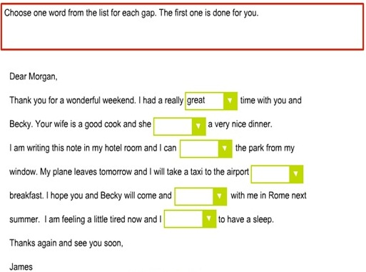
TASK TYPES

Slide 14
TASK TYPES
Task 2 – Arranging Sentences
- Put the sentences into the correct order to make a story.
- Multiple sentences.
- Click on the sentence.
- Drag it to its correct place.

Slide 15
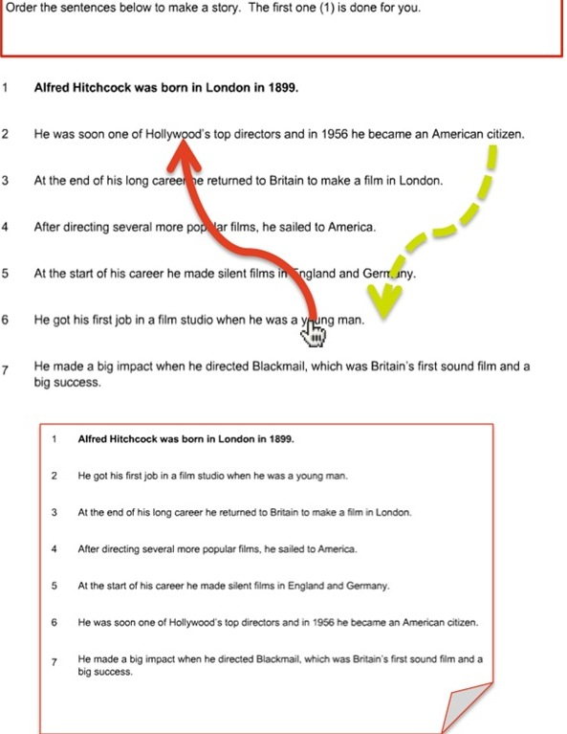
TASK TYPES

Slide 16
TASK TYPES
Task 3 – Gap fill
- Text of 150 words.
- 10 words to choose from.
- 7 spaces.
- Drag the correct word into the empty box.
- You can change the words if you change your mind.

Slide 17
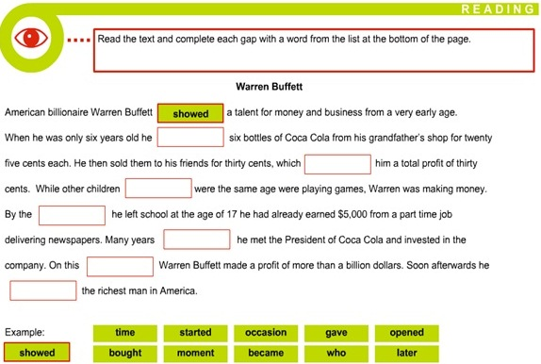
TASK TYPES

Slide 18
TASK TYPES
Task 4 – Choosing Headings
- A long text of 750 words
- Match the headings to the paragraph
- The answer is not obvious.
- Scroll down on the side bar to see the whole text

Slide 19
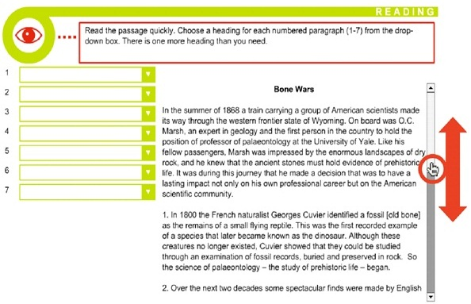
TASK TYPES

Slide 20
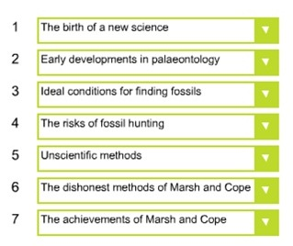
TASK TYPES

Slide 21
TIPS
Watch your watch. It’s important that you finish all tasks in 30 minutes.
Remember to read all the questions very carefully
Pay attention to key words in the questions
Scan for paraphrases of key words
Skim and scan for information
You should guess meaning from context
Answer every question even if you’re not sure
Don't become anxious if there are questions you cannot answer. Leave them and move onto the next questions. You can always come back to the ones you couldn’t answer at the end of the test if you have time.

Slide 22
SKILLS
TO PRACTICE
  Guessing the meaning of unknown words from context
  Reading quickly
  Scanning (locating names/nouns that occur in the text; locating synonyms)
  Locating the main idea
  Vocabulary → use learner’s dictionaries (which offer a lot of example sentences to help you with usage); avoid using bilingual dictionaries
  Paraphrasing

